Slide 1
“Forgetting of Friends and its Effects on Measuring Friendship Networks” Devon Brewer and Cynthia Webster
Cathy Zhuang

Slide 2
Introduction and Methods
Which individuals are most likely to forget friends? What kinds of friends are being forgotten? What impact does forgetting have on the structural properties of social networks?
Residents had opportunities to interact with each other in multiple social settings
Recall: Residents were asked to write the names of those residents whom they considered to be personal friends (not including acquaintances)
Forgotten: After being provided a list of all residents, subjects went through this list and wrote down anyone whom they also considered to be a friend but had forgotten to include earlier. Once their list of friends was complete, subjects rated the strength of their relationship for each friend on a five-point scale.
Notes:
They were provided with a blank sheet of paper and asked to write the names of those residents whom they considered to be personal friends. A friend was defined as ‘‘those individuals who you feel close to, who you interact with frequently, those who you would seek out to do some type of social activity.’’ Subjects were not limited in the number of friends to name, but they were instructed not to include residents who were only acquaintances.
After completing the recall task, subjects were then provided with a list of names of all the residents Žin alphabetical order. who were currently living in the residence hall. They were asked to go through this list and write down anyone whom they also considered to be a friend, but had forgotten to include earlier. Throughout the rest of the paper, we refer to the friends reported in this recognition task as ‘‘recognized friends’’ or ‘‘forgotten friends.’’ Once their list of friends was complete, subjects rated the strength of their relationship for each friend on a five-point scale Ž5sbest friend, 4sclose friend, 3sfriend, 2sfriendly acquaintance, and 1sacquaintance..

Slide 3
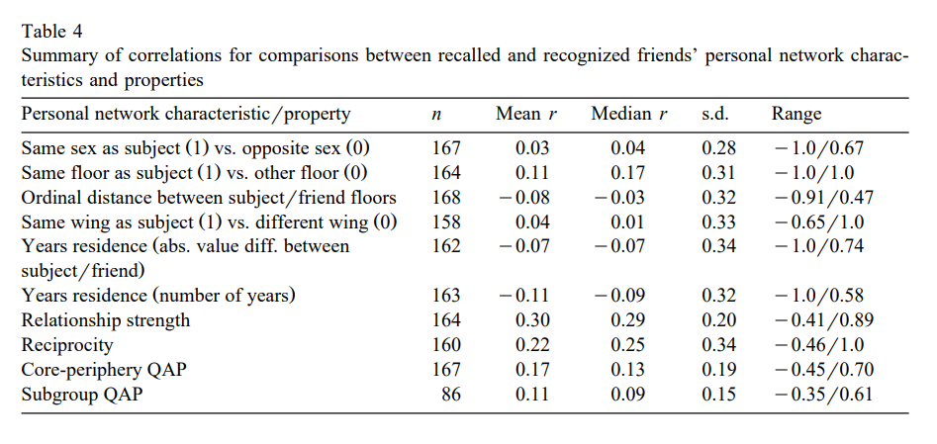
Results
Notes:
CALCULATIONS
To compare recalled and forgotten friends, we calculated, for each subject who forgot one or more friends, the Pearson point biserial correlation between whether a friend was recalled (yes-2, no-1) and each of a number of friend individual, relationship, and structural characteristics.
Then, for each characteristic, we computed the unweighted mean of subjects’ correlations by using Fisher’s z-transformations.
In those cases where a friend characteristic variable is measured on an ordinal scale, we also calculated a version of Freeman’s theta, the bivariate proportional reduction of error measure of association between a nominal scale variable and an ordinal scale variable.
RESULTS
Subjects were essentially equally likely to recall same-sex and opposite-sex friends
Subjects were slightly less likely to recall friends who lived on floors other than their own
The likelihood of recalling a friend is very weakly negatively related to the ordinal floor distance, which is the number of floors one would have to ascend or descend
Recalled and forgotten friends were virtually equally likely to live in the same wing of the residence hall as the subject
Subjects were very slightly more likely to recall friends who had lived in the residence hall for a similar length of time as themselves than friends who lived in the hall for different either shorter or longer lengths of time. Friends who lived in the residence hall for relatively shorter periods were slightly more likely to be recalled than friends who had been living in the hall for relatively longer periods.
Subjects displayed, on average, a modest tendency to have closer relationships (stronger relationship strengths) with recalled friends than recognized friends.
Subjects’ recalled friendship choices were some-what more likely to be reciprocated (by either a recalled or recognized choice) than their recognized friendship choices
QAP Used Quadratic Assignment Procedure on two hypotheses
The first hypothesis is that recalled friends form the ‘‘core’’ of a subject’s personal network and that forgotten friends are structurally more peripheral in the subject’s personal network.
The second hypothesis is that recalled friends and recognized friends constitute distinct subgroups in which all recalled friends are directly tied to each other, all recognized friends are directly tied to each other, and recalled friends and recognized friends constitute non-overlapping clique
On average across subjects, forgotten i.e., recognized friends are slightly more peripheral in a subject’s personal network than recalled friends. That is, recognized friends tend to have slightly fewer ties with each other or with recalled friends than recalled friends have with each other.
This suggests that the ‘‘core-periphery’’ hypothesis provides a better, albeit still poor, description of the data than the ‘‘subgroup’’ hypothesis.

Slide 4
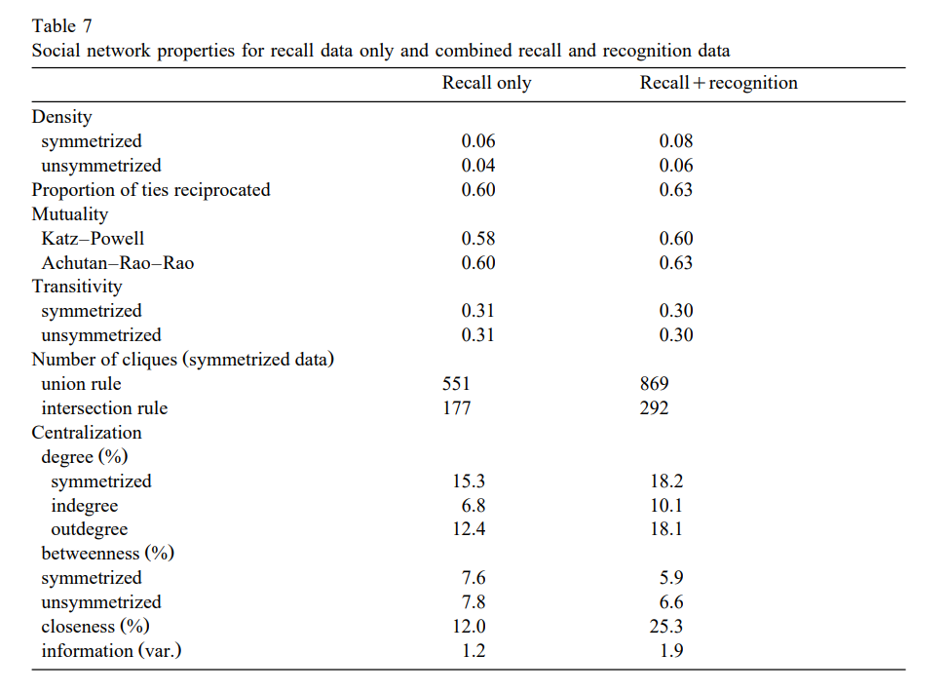
Results
Notes:
METHODS
To assess the impact of forgetting on measurement of social network properties, we created one 217x217 matrix based on recall data only and another based on the combined recall and recognition data.
(We used symmetrized data because the two hypotheses tested refer to interaction patterns, which by definition involve symmetric ties. In essence, we used the friendship data as a proxy for data on interaction. )
We measured several network properties, including density, reciprocity, mutuality, transitivity, number of cliques, and four types of centralization.
RESULTS
Density increases roughly in proportion to the amount of additional ties included with the recognition data.
The level of reciprocated ties and mutuality of friendship choices also increase slightly once the recognition data are added to the recall data.
The level of transitivity is essentially the same whether the recall data only or combined recall and recognition data are used. (The transitivity values in Table 7 indicate the proportions of unordered triads that are transitive for the symmetrized data and the proportions of ordered triples that are transitive for the unsymmetrized data.)
The number of cliques of size 3 rises meaningfully for the symmetrized data (based on the union rule as well as the intersection rule).
Degree centralization rises somewhat, betweenness centralization falls slightly, closeness centralization increases substantially, and information centralization rises moderately after including the forgotten ties.

Slide 5
Discussion Questions
What impacts does adding the forgetfulness data have on social network structure?
Is forgetting to recall personal and social network members significant?
What is the purpose of symmetrizing the data? Why would we want to compare symmetrized to unsymmetrized data?
Notes:
We used symmetrized data because the two hypotheses tested refer to interaction patterns, which by definition involve symmetric ties. In essence, we used the friendship data as a proxy for data on interaction.
Forgetting had little or no impact on the measurement of some social network properties, but had more moderate impact on others. The recall data and the combined recall and recognition data display noteworthy differences in social network density, number of cliques, most measures of centralization, and some measures of individuals’ centrality (most notably, closeness).

